Slide 1
Chada tech agile retrospective
Brooklen Ashleigh
CS250 - February 17th, 2023

Slide 2
AGENDA
What and Who is Agile?
Agile SDLC Phases
How is Agile Different?
Why We Choose Agile

Slide 3
What is agile?
The Agile Methodology enables teams by creating a project structure that encourages change, open communication, and an explicit desire to meet the customer’s needs. It means teamwork, iteration, and flexibility (Cobb, 2015).

Slide 4
WHO Is Agile?
“Teamwork, iteration, and flexibility.”
How do teams make this happen?

Slide 5
Agile teams use three specific roles
PRODUCT OWNER
Interfaces directly with customers and stakeholders to collect information about the desired product and vision
Grooms the product backlog and organizes client needs into user stories
Is the authority on the customer’s vision
SCRUM MASTER
Manages Scrum Events and enforces Agile practices
Keeps the Development Team on track and removes any roadblocks in their path
DEVELOPMENT TEAM
Organizes and estimates user stories based on their difficulty using Story Points or other estimation methods
Completes customer deliverables within Sprint Cycles
TESTERS
Use test cases to verify product functionality and that the details of each user story match the client’s intention

Slide 6
Agile sdlc phasing
How does an Agile team organize their workflow?

Slide 7
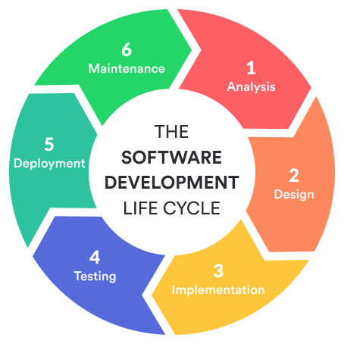
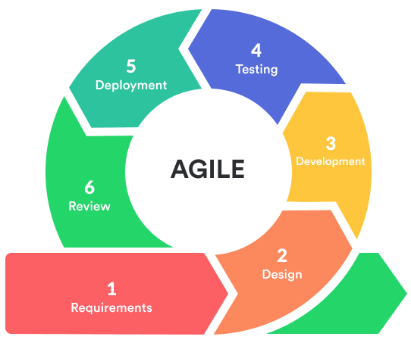
Agile sdlc phasing
The Software Development Life Cycle uses six common phases to outline the stage that a product is in.
Agile uses a slightly different structure that loops fully many times over the course of the project, in the form of Sprints.

Slide 8
Agile sdlc phases
Phase 1: Requirements
The Product Owner communicates with stakeholders to assess the initial needs of the customer and product. After the initial Sprint, this is based on customer feedback from the previous Sprint, which the the Product Owner uses to groom the Product Backlog.
Phase 2: Design
The team plans the overall framework of the project or individual piece of the project, including what programming languages to use, server designs, etc.
Phase 3: Development
The Development Team builds the product based on the user stories required in that Sprint period.
(Bitbytesoft, 2022)

Slide 9
Agile sdlc phases
Phase 4: Testing
Development Team testers test the current iteration of the product using test cases to verify the product works and that completed user stories fit the client’s expectations.
Phase 5: Deployment
The current iteration of the product is brought to a deployable state where it can be used as a functional product and tested fully.
Phase 6: Review
A Sprint Review is conducted to obtain stakeholder and client feedback on the deployed release of the product to integrate into the next Sprint Cycle.
(Bitbytesoft, 2022)

Slide 10
How is agile different?
Agile vs. Waterfall

Slide 11
Agile philosophies
“Working software is the primary measure of progress”
(Cobb, 2015).
Less Upfront Planning
Upfront planning and extensive documentation are time consuming, and do not enable easy change
Deployable software as soon as possible
Constant Communication
Constant communication during the development progress with clients and stakeholders
Continuous Improvement
Iterations that demonstrate the product to the client
Collecting of feedback based on the product to inform changes and new features to be integrated going forward

Slide 12
WATERFALL PHILOSOPHIES
Because the requirements are clearly laid out from the beginning, each contributor knows what must be done when, and they can effectively plan their time for the duration of the project.
(Adobe Communications Team, 2022)
Upfront Planning
“The Waterfall methodology depends on the belief that all project requirements can be gathered and understood upfront” (Adobe Communications Team, 2022).
Linear Development
The Waterfall Method follows a linear path of Requirements, Design, Implementation, Testing, then Deployment and Maintenance (Adobe Communications Team, 2022).
Easy Cost and Risk Estimation

Slide 13
So, which is better?
During our recent SNHU Travel Project, the customer decided to pivot their travel website to an entirely different theme based on external trends. How would this look in an Agile or Waterfall scenario?
Agile Scenario
The customer’s new vision was communicated to the team immediately
The Development Team was able to immediately change tack and edit their existing product to account for this new vision, with only a few follow-up questions needed
Because they were notified early, the impact was minimized
Waterfall Scenario
The customer’s vision would be heavily researched and planned in the beginning of the design process
The customer would not see the deployable product until the end of development
Any changes to the initial plan or existing product would be very costly

Slide 14
Why We choose agile
And why Chada Tech should too.

Slide 15
Why Agile?
The Agile Methodology is best when:
The project expectations are not fully defined
Change or additional requirements are guaranteed or expected
The project is feature driven
Customer interaction is possible
(Cobb, 2015)

Slide 16
Why Agile?
The Waterfall Method is best when:
The project expectations are fully defined from the beginning and unlikely to change
Early estimation and risk assessment are a must
The project must meet strict, unchanging guidelines or standards
Customer interaction is not possible
(Cobb, 2015)

Slide 17
Why Agile?
In the SNHU Travel Scenario:
Agile was an excellent choice because we were able to interact with the customer to constantly evolve the product while also incorporating changes and feedback to efficiently pivot and meet the customer’s true vision.
A Waterfall scenario would have meant a much more difficult and costly time trying to respond to the customer’s evolving needs, and we would likely not have met the customer’s time restrictions, which would have likely meant loss of business.

Slide 18
SUMMARY
Agile Retrospective
Chada Tech’s recent foray into Agile Methodologies has given us a clear idea of the advantages and downsides to both Agile and Waterfall methods. We found considerable benefits from using an Agile Methodology and wish to pursue a conversion to this method.

Slide 19
REFERENCES
Agile Retrospective
Adobe Communications Team. (2022, March 18). Waterfall Methodology: A Complete Guide. Adobe Experience Cloud Blog. Retrieved February 17, 2023, from https://business.adobe.com/blog/basics/waterfall
Bitbytesoft. (2022, April 26). The phases of Agile Software Development Life Cycle & Workflow and Project Management. Bitbytesoft.com. Retrieved February 17, 2023, from https://bitbytesoft.com/phases-of-agile-software-development-life- cycle/#Phase_1_Concept_Requirement
Cobb, C. G. (2015). The Project Manager's Guide to Mastering Agile : Principles and Practices for an Adaptive Approach. Wiley.

Slide 20
THANK YOU
Brooklen Ashleigh​
Brooklen.Ashleigh@snhu.edu

